Slide 1
Money Smart Month
2022 SENIOR MONEY SMART EXPO
April 6, 13, 20, 27, 2022 I 10:00 AM-12:00 PM
Notes:
MANAGING YOUR MONEY AND MORE FOR HEALTHCARE NAVIGATORS

Slide 2
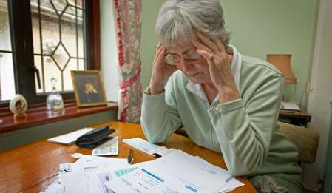
WELCOMES YOU TO
Senior Money Smart Event – Utilizing Technology to Claim Your Financial Independence
‹#›
Notes:
The Benefits Access Committee of the Senior Regional Collaborative is proud the make this Boost Your Budget Webinar Series available to older adults in the tri-county area. Our earlier Senior Money Smart Expo slated for April 16, 2020 was cancelled due to the Covid-19 pandemic.
‹#›

Slide 3
Zoom Instructions:
HAVE A PLAN THAT SIMPLIFIES YOUR FINANCIAL SITUATION
UNMUTE YOURSELF BY PRESSING*6, STATE YOUR NAME AND ASK THE QUESTION AFTER YOU ARE CALLED UPON.
FOR CHINESE TRANSLATION: PRESS THE GLOBE ICON AT THE BOTTOM OF YOUR SCREEN AND SELECT THE CHINESE OPTION. ALSO MAKE SURE TO SELECT “MUTE ORIGINAL AUDIO.”
‹#›
Notes:
‹#›

Slide 4
SRC MISSION & VISION
SRC MISSION
To improve the quality of life for all older adults and people with disabilities in the region through capacity building and strategic leadership.
SRC VISION
A region where SRC members combine their collective strength to ensure older adults and people with disabilities live healthier, more fulfilling and productive lives.
Notes:
Audra will re-welcome everyone on behalf of the SRC and welcome everyone to Money Smart - Utilizing Technology to Claim your Financial Freedom
Say: The Senior Regional Collaborative is a non-profit association of government and non-profit organizations that serve seniors and persons living with disabilities. We provide our member organizations with networking, training and funding opportunities—helping them to build partnerships and improve the quality of life for older adults and people with disabilities in southeast Michigan.

Slide 6
Money Smart Event
EVENT SPONSORS
Special Thanks to our event sponsors:
Elder Law of Michigan
Detroit Area Agency on Aging
Association of Chinese Americans
SRC Benefits Access Committee
‹#›
Notes:
‹#›

Slide 7
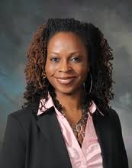
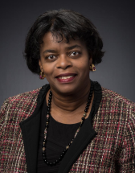
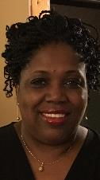
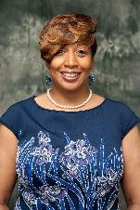
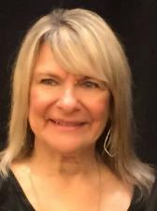
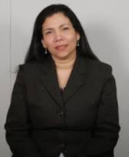
Today’s Line Up
Senior Money Smart Experts
Left to Right: Kristie King, Association Executive, Senior Regional Collaborative; Anne Holmes Davis, Vice President – Planning and Program Development, Detroit Area Agency on Aging; Indea May, DNP, RN, FNP-BC, Clinical Instructor, Wayne State University’s College of Nursing; Josephine Messelmani, R.N, M.S.N, Vice President Long Term Care Services and Support, Detroit Area Agency on Aging; Joyce Holly, Benefit Navigator, St. Patrick’s Senior Center; Kathi Sitek, V.P. of Business Development and Certified Financial Coach, Diversified Members Credit Union; Darling A. Garcia, JD LLM, President and CEO, Elder Law of Michigan.
‹#›
‹#›
Notes:
‹#›

Slide 8
Money Smart Event
Indea May, Clinical Instructor, Wayne State University College of Nursing - Telehealth
Josephine Messelmani, Vice President of Long Term Care Services & Support, Detroit Area Agency on Aging - Telehealth
Joyce Holly, Benefit Navigator, St. Patrick’s Senior Center - Online Grocery Shopping
Kathi Sitek, Vice President of Business Development & Certified Financial Coach, Diversified Credit Union - Online Banking
Darling A. Garcia, President & CEO, Elder Law of Michigan - Five Key Benefits for Seniors
‹#›
Notes:
‹#›

Slide 9
Money Smart Event
Today we will answer these big questions . . .
How can I grocery shop online and create an account?
How can I use online/mobile banking safely and securely?
What is Telehealth and what healthcare services are offered online?
What should I know about the five key benefits that older adults may qualify for during their retirement years?
How can I get the most out of senior benefits?
‹#›
Notes:
‹#›

Slide 10
.
know the five
key benefits
how to use
technology
avoid senior scams and
protect your identity
‹#›
Notes:
‹#›

Slide 11
TELEHEALTH Combating Health
Disparities via Access To Healthcare Dr. Indea May, DNP, RN, FNP-BC
Senior TelehealthConnect
DAAA
Josephine Messelmani, RN, MSN

Slide 12
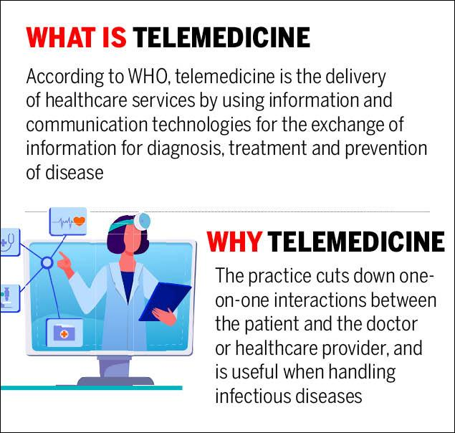

Slide 14
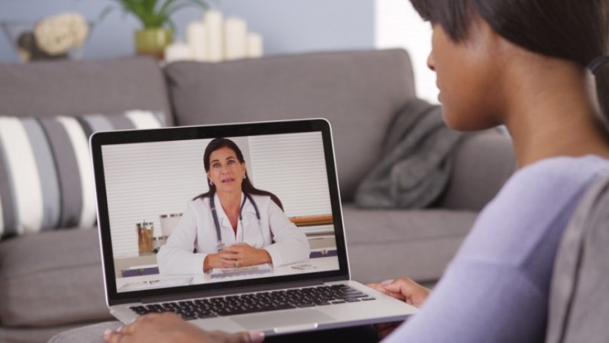
ACCESS to HEALTHCARE
Peace of mind to be able to attend appointments.
No Case Manager needed.
Acute concerns timely & conveniently addressed.
HIPPA compliant (privacy)
This Photo by Unknown author is licensed under CC BY-SA.

Slide 15
BARRIERS of TELEHEALTH
Poor internet connection.
Phone or tablet not compatible.
Conflict with appointment time.
Provider wait time.
This Photo by Unknown author is licensed under CC BY-SA-NC.

Slide 16
BARRIERS of TELEHEALTH
Visit may go from video to telephone due to failure w/ technology.
Lack of hands-on assessment.
This Photo by Unknown author is licensed under CC BY-SA-NC.

Slide 17
BENEFITS of TELEHEALTH
Staying connected with your healthcare provider. No more missed appointments.
Provides socialization by way of video chat.
Options of video and audio.
Increase patient compliance.
Have acute concerns addressed conveniently
This Photo by Unknown author is licensed under CC BY-NC-ND.

Slide 18
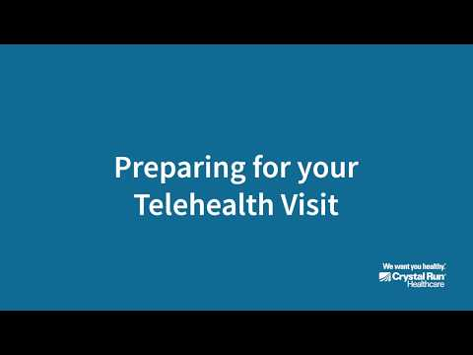
BENEFITS
Decreased hospitalizations.
Decrease cost to patient and overall wellness cost.
Increased efficiency of patient planning and results

Slide 19
HOW TO PREP FOR YOUR TELEHEALTH VISIT Video From Crystal Run Health

Slide 20
ASK YOUR HEATHCARE PROVIDER.....
This Photo by Unknown author is licensed under CC BY-SA-NC.
This Photo by Unknown author is licensed under CC BY-NC-ND.

Slide 21
ASK YOUR HEALTHCARE PROVIDER.......
How Do I make a telehealth appointment?
How Do I access the patient portal?
Is there a link or app that I must connect to?
Will someone call to verify my appointment and connectivity prior to the appointment day?
Will a medical assistant be coming to my home during the visit?
Should I click on the link 5 to 10 minutes before the visit?
Is my co-pay due at the time of the visit?

Slide 23
Senior TeleHealthConnect Strategic Plan Alignments
Management of Social Determinants of Health
Engage patients to identify barriers to care
Relay social determinants to the care team
Triage/refer patients to needed resources
This Photo by Unknown Author is licensed under CC BY-NC-ND

Slide 24
Core Services
Telemedicine
Evaluation + Management through live video and audio
Chronic Care Management
Maintaining a comprehensive electronic care plan
Managing transitions of care and other care management services, and
Coordinating and sharing patient health information timely within and outside the practice,
Remote Patient Monitoring
Utilizes digital technologies to collect medical and other forms of health data from individuals in one location and electronically transmit that information securely to health care providers in a different location for assessment and recommendations.

Slide 25
Additional Services
Primary Care Services
Annual Physicals
Preventive Care Management
Medical Nutrition
Transitional Care Management
Substance Abuse/Behavioral Health
Diabetes Self-Management Training
Medical Nutrition Services
Chores Services
Home Delivered Meals
Respite Care
Training for Caregivers
Community Living Services
Counseling Services
Private Duty Nursing
Transportation
Personal Emergency Response System

Slide 26
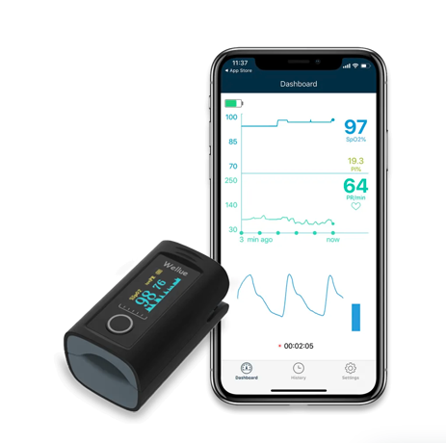
Remote Patient Monitoring
Remote patient monitoring of specific vital signs which may include, blood pressure, heart rate, pulse oximetry, weight, and blood sugar.
Disease specific educational videos and patient surveys delivered via telehealth tablet.
Connecting remotely with patients via video communication tools and the ability to take photographs for clinical purposes.

Slide 27
Target Population Serving Our Constituents
Medicaid/Medicare - Other Health Plans Welcome
Veterans Administration
2 or More Chronic Conditions
Age 65 or Older, Adults with Disabilities
Requires support managing co-morbid diseases

Slide 28
Credentialed Professional Staff
Certified, Credentialed Doctors
Nurse Practitioners
Registered Nurses
Registered Dietitian
Licensed Social Workers
Case Managers

Slide 29
ANY QUESTIONS............

Slide 30
GROCERY SHOPPING ONLINE
PRESENTED BY JOYCE HOLLY
ST PATRICK SENIOR CENTER

Slide 31
INTRO
Most major grocery store chains have online ordering options. Usually it is as easy as going to their website and looking at the top menu on their website. Depending on where you live they will give you options for grocery pick-up and sometimes even delivery to your home. Many chains offer free grocery pick-up either same day or next day, while some will charge a small fee. Sometimes busy times cost a fee while less busy times are free. Most delivery options do involve fees and also tips for your driver. You will see what is available to you on your grocer’s website. Check with your chain for their specific terms.

Slide 32
BENEFITS OF SHOPPING ONLINE
Shopping online can save you money
Avoid crowded stores and long shopping lines
Contactless shopping

Slide 33
How To Get Started
Let’s get started by creating a shopping list
Go to the official website of the store that you would like to shop, be sure that the name appears In the browser.
For this demonstration, we will use Kroger https://www.kroger.com

Slide 34
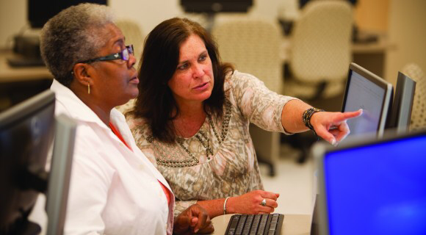
How to Create An Account

Slide 35
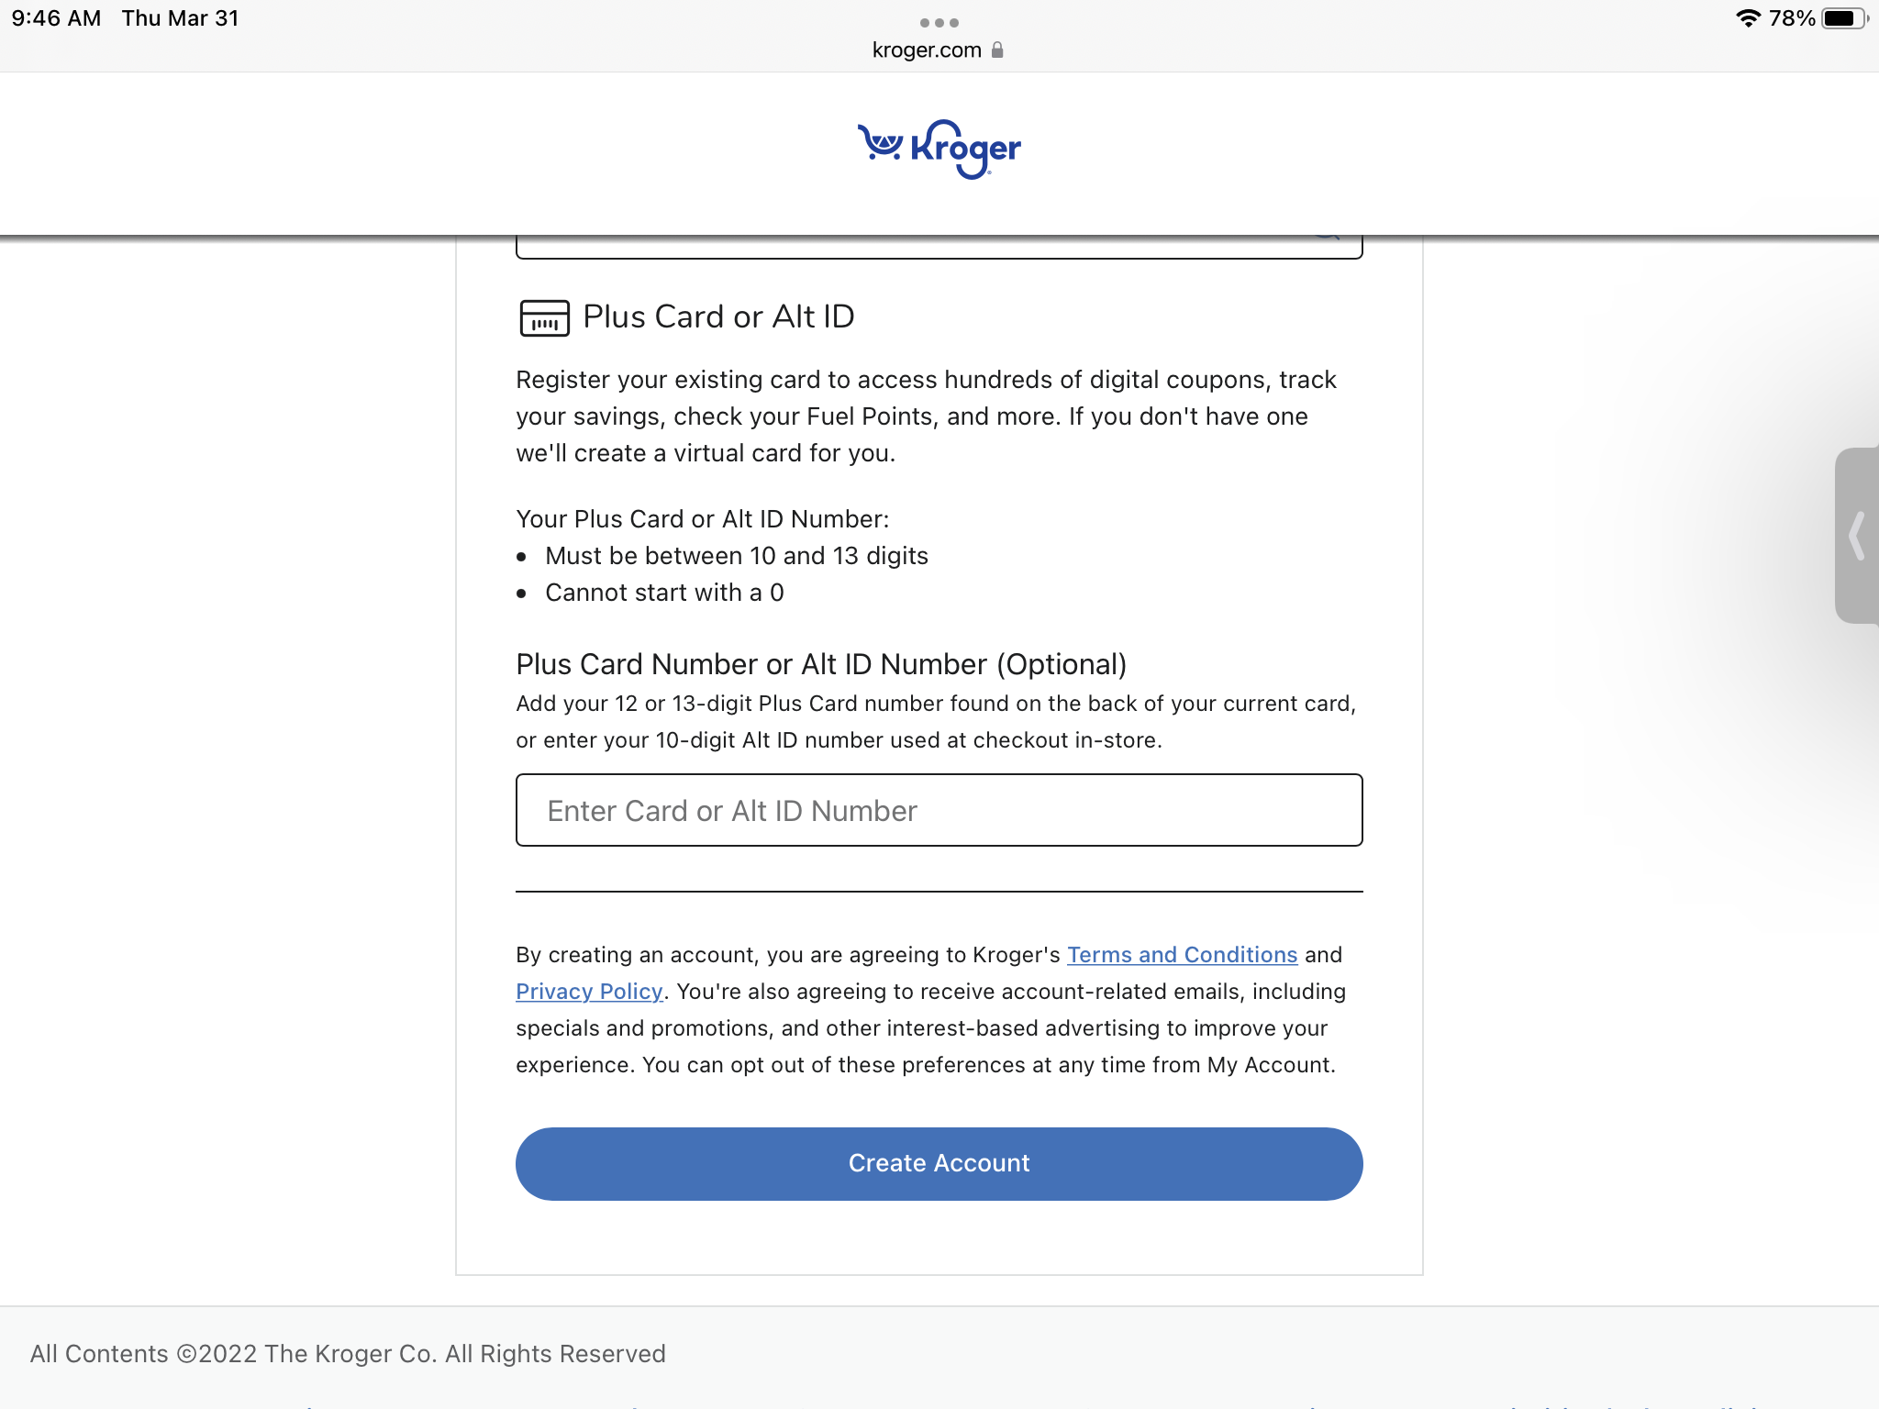
Create an Account (Cont.)

Slide 36
Select a Grocery Store

Slide 37
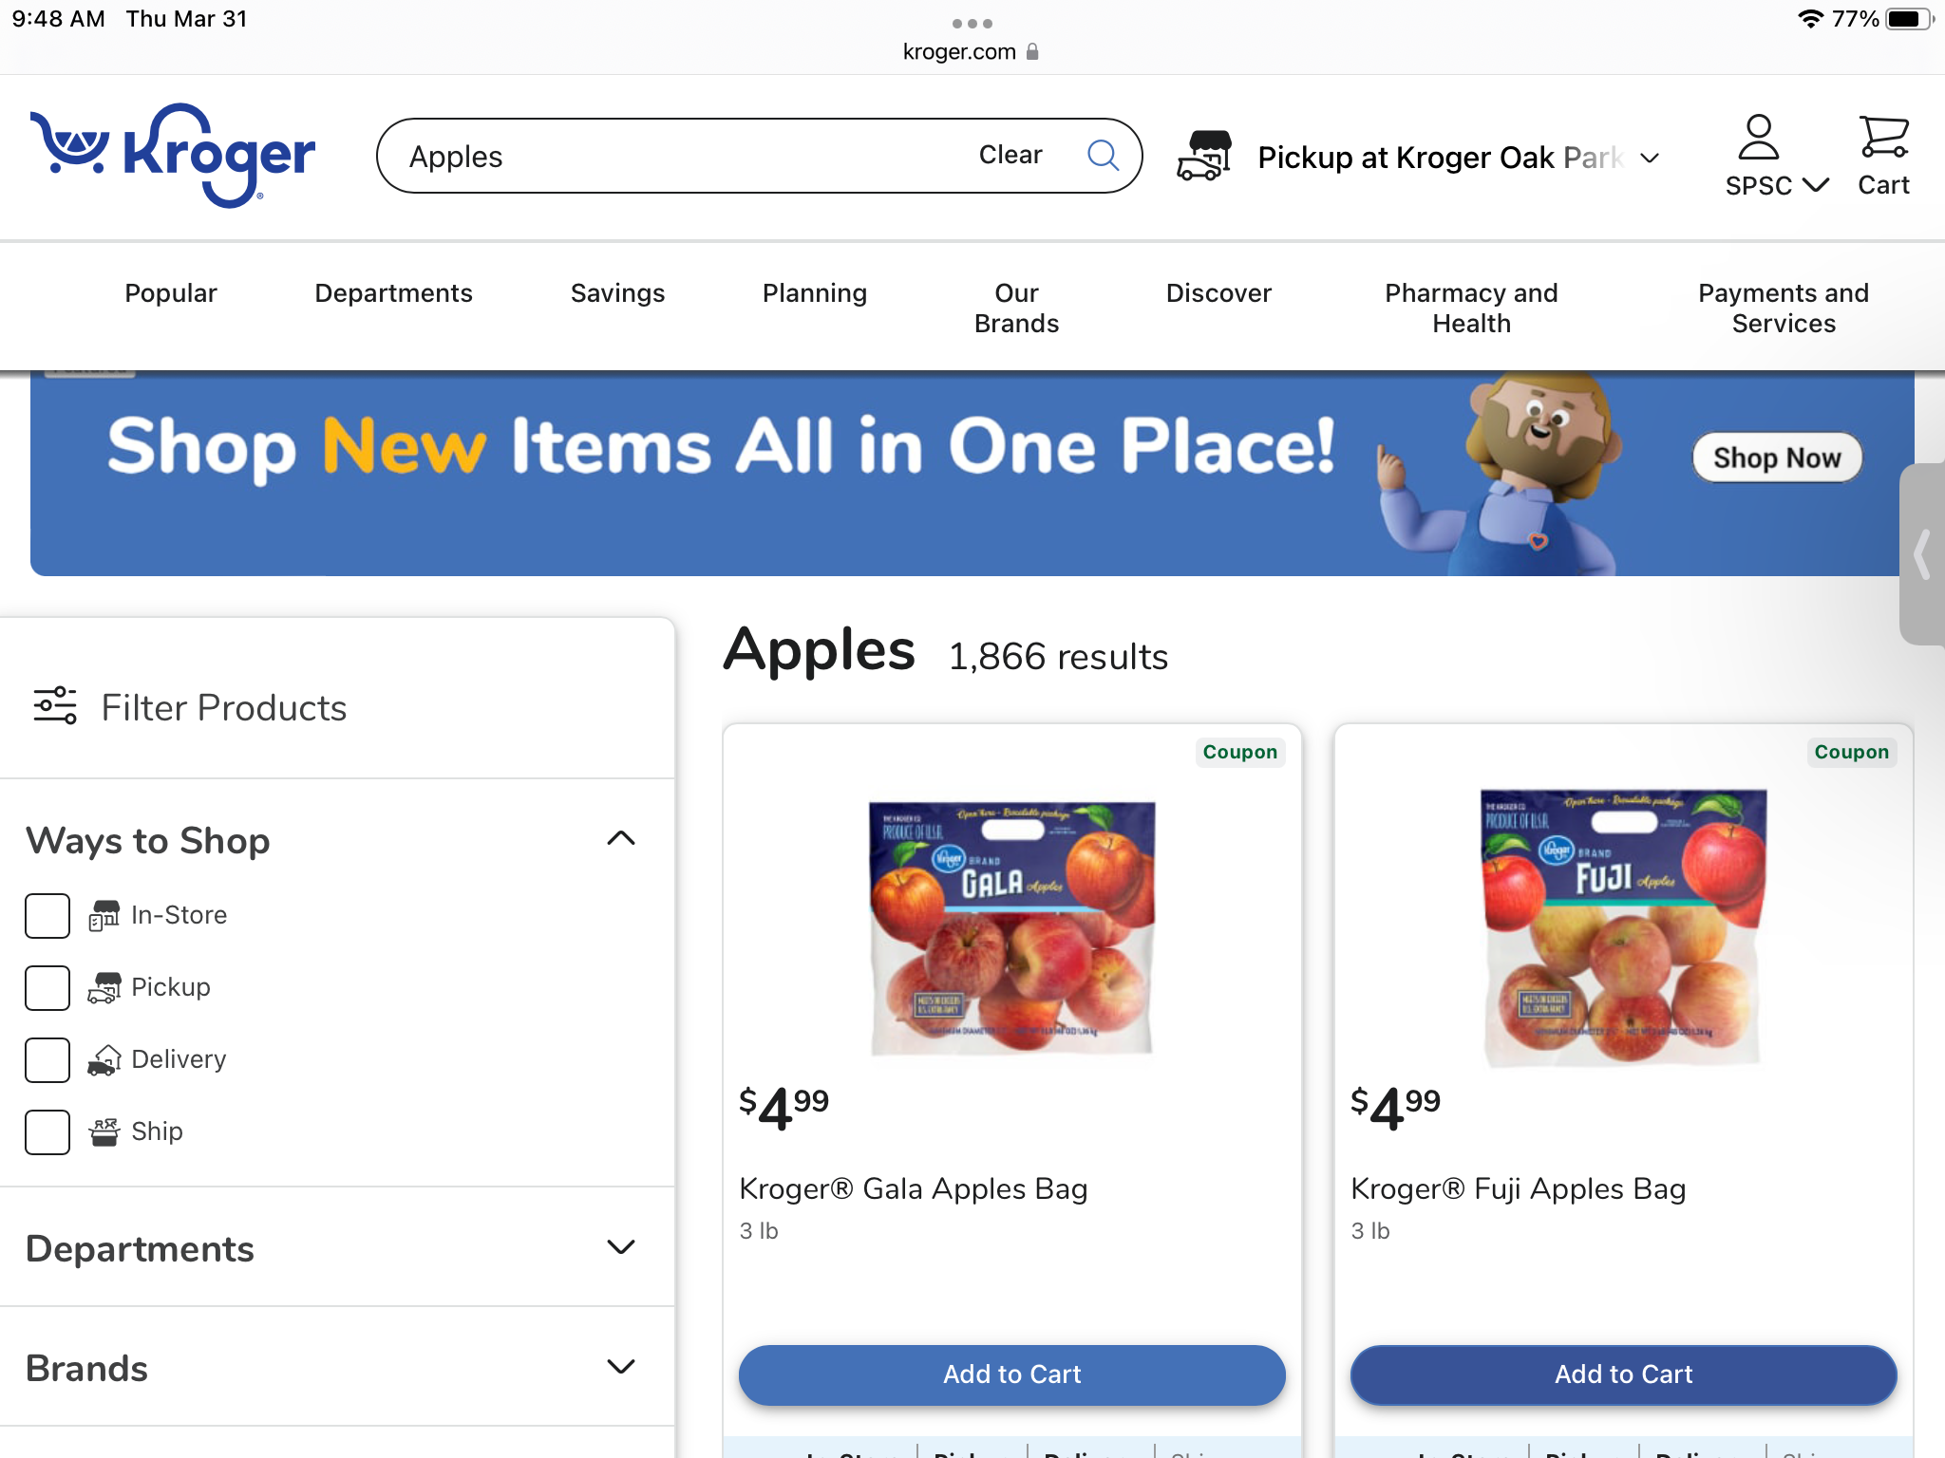
STEP 1
While each store is a little different, the basic process is the same. First, you search for items using their search bar and add them to your cart.

Slide 38
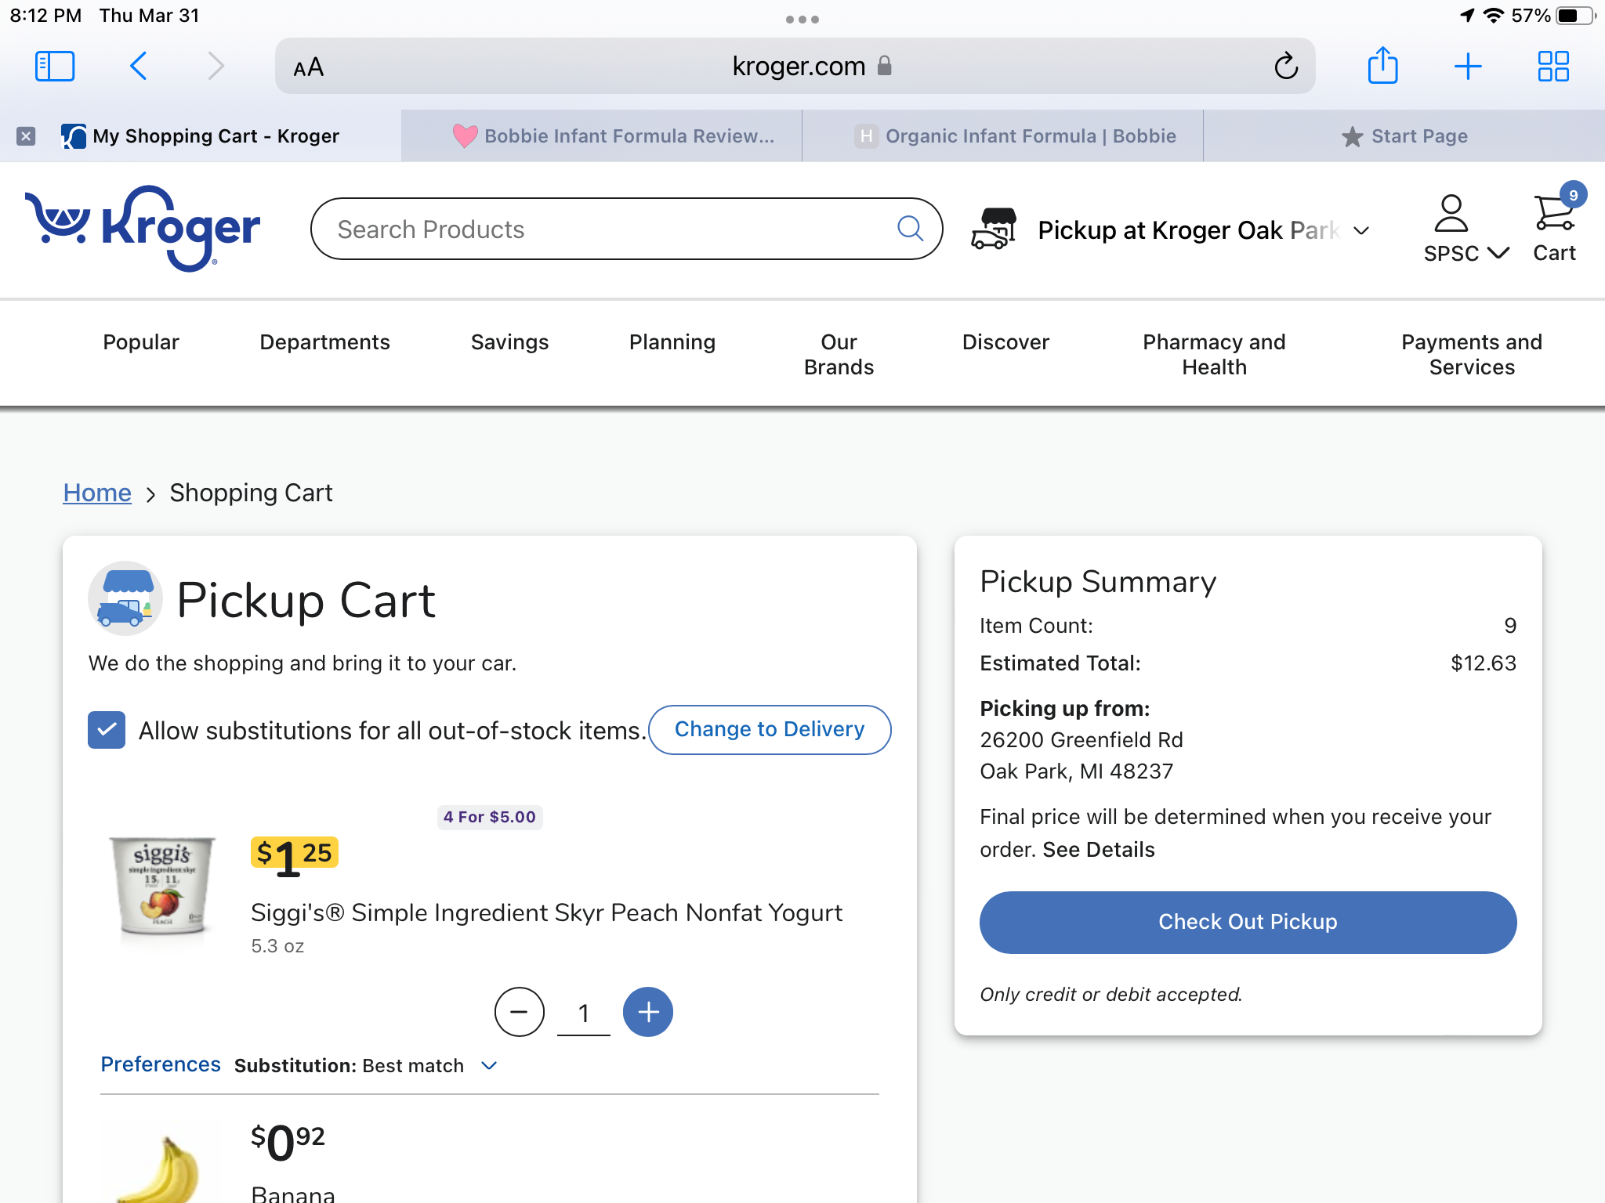
SHOPPING CART
NOTE: You Can View/Edit Your Cart While Shopping

Slide 39
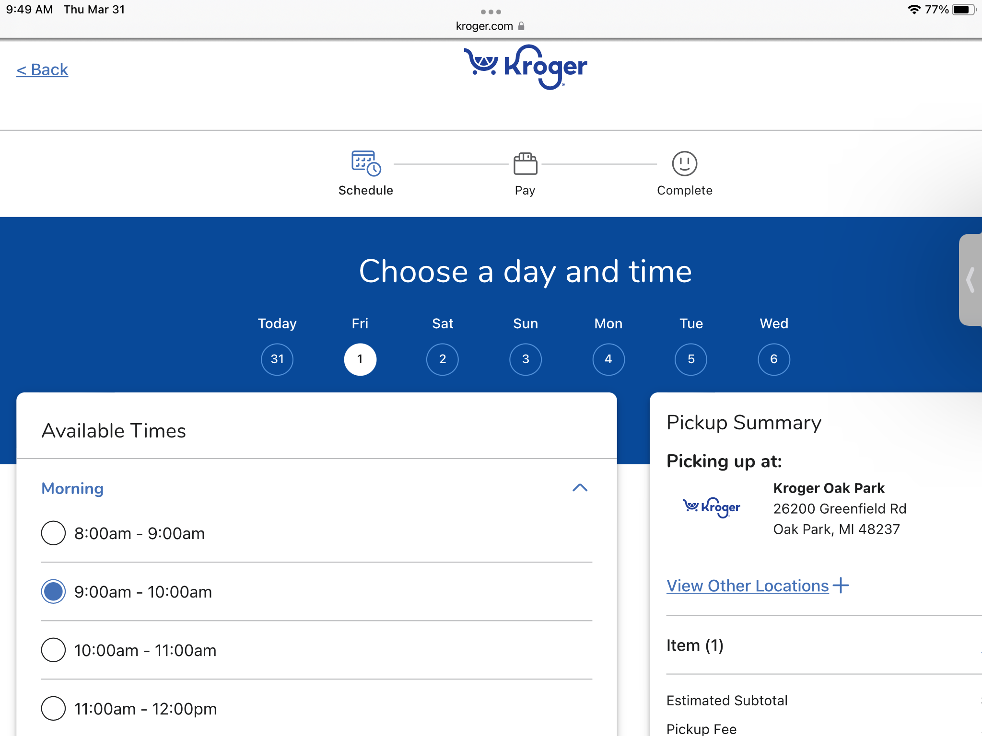
STEP 2
Then, when you are ready to check out you are prompted to pick a pickup or delivery time. Normally there will be plenty to choose from. However, during holidays and emergencies, you may have limited times to choose from.

Slide 40
ONLINE GROCERY SHOPPING TIP
ONLINE GROCERY SHOPPING TIP: IF BY CHANCE THERE ARE NOT ANY TIME SLOTS, TRY AGAIN IN A FEW HOURS OR THE NEXT DAY. IF YOU HAVE MADE AN ACCOUNT AND LOGGED IN, YOUR ITEMS IN YOUR CART SHOULD SAVE UNTIL YOU CAN FIND A TIME SLOT.

Slide 41
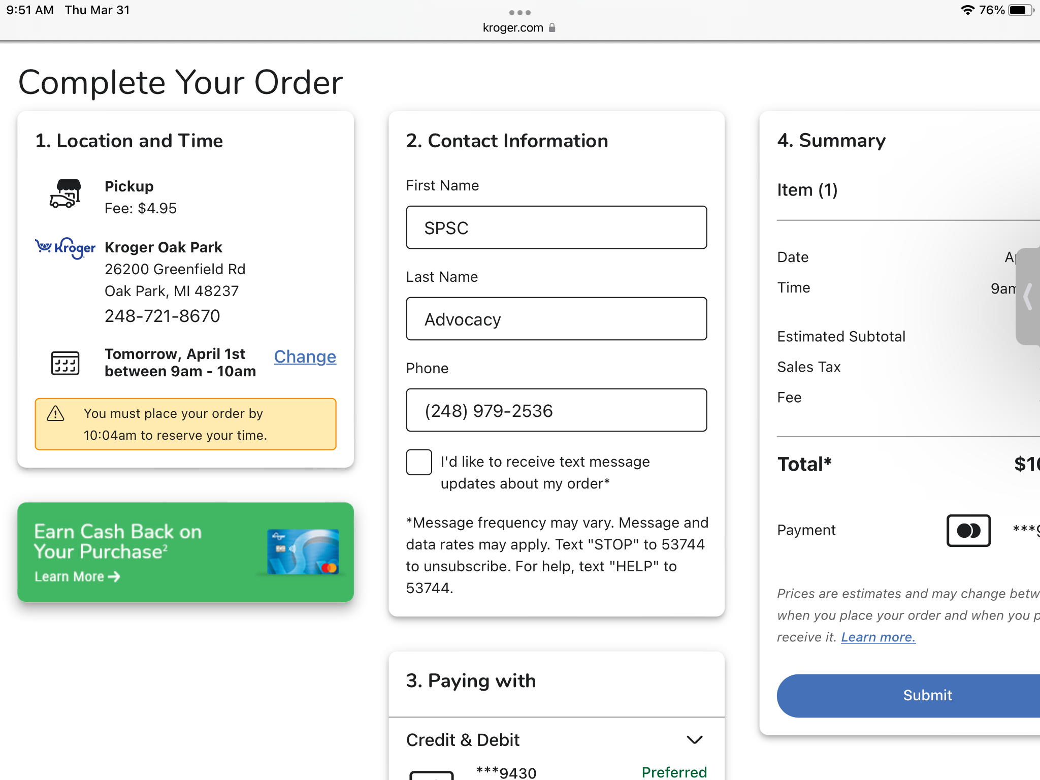
STEP 3
Before checking out with your credit card, most stores will ask you if you allow substitutions on items. Most stores default to allowing substitutions, however if there are specific things that you don’t want substituted, you can usually opt out by un-checking those items.

Slide 42
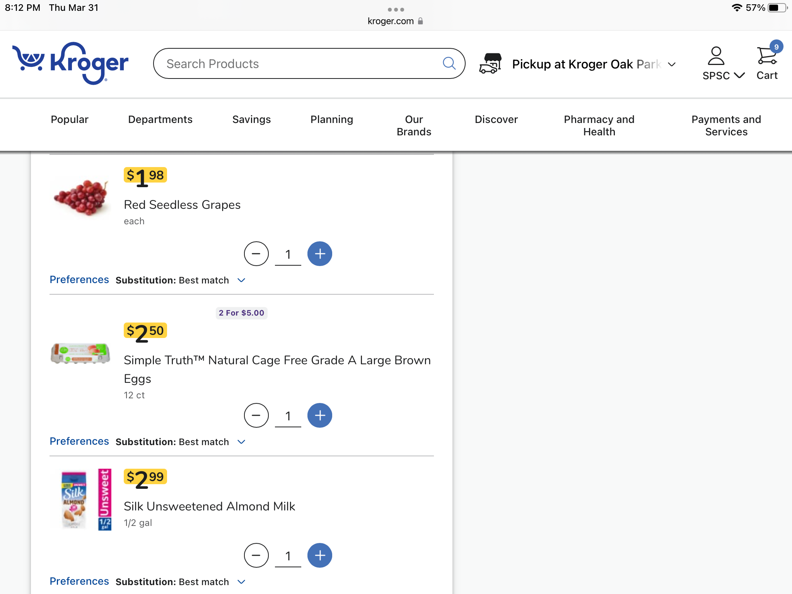
SUBSTITUTIONS

Slide 43
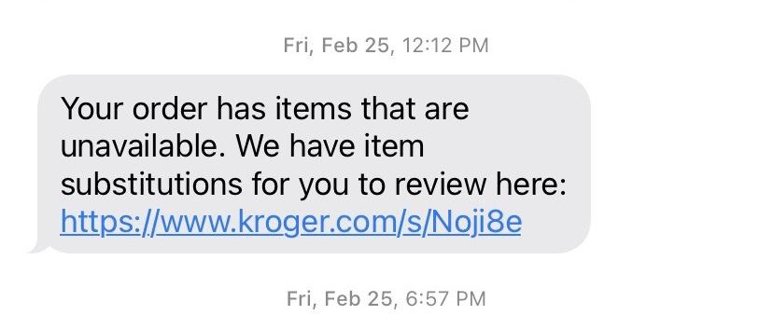
STEP 4
Once your time slot approaches, an employee will go handpick your items and set them aside for you. If an item is out of stock, they will try to substitute it or if there is no suitable substitution they will just deduct the item from your bill. You will usually get an email or text about any out of stock or substitutions before it is time for you to arrive.

Slide 44
STEP 5
If you are doing grocery pick up, the store will send you a notification that your order is ready, you simply drive to the store and park in a designated spot. They usually have a number you can call to tell them you are there. You do not need to get out of your car. The employee will load the item in your car for you. All they need from you is a signature.

Slide 46
References
Information in this PowerPoint is from https://www.recipesthatcrock.com/how-to-order-groceries-online/

Slide 47
Online and Mobile Banking
Learn how to use online & mobile banking securely to improve your financial habits and simplify daily financial tasks.
Presented by Kathi Sitek, V.P. Business Development & Certified Financial Coach

Slide 49
What is online/mobile banking?
Online/mobile banking is making financial transactions on a mobile device or computer that you might otherwise conduct in person at a financial institution such as a bank or credit union.

Slide 52
Why use mobile & online banking?
It’s simple, flexible, and convenient. You can access your bank information, transfer money and make payments wherever you have an internet connection — even on Sundays and holidays when financial institutions are typically closed.
It’s secure. Online and mobile banking may be more secure than carrying around credit or debit cards, which have account numbers and magnetic strips on them, making it easier for them to be stolen or compromised.
It can improve your ability to monitor your finances. By checking your account balances or available credit in real time, you can avoid spending more than your available balance, which may result in pricey overdraft fees.

Slide 57
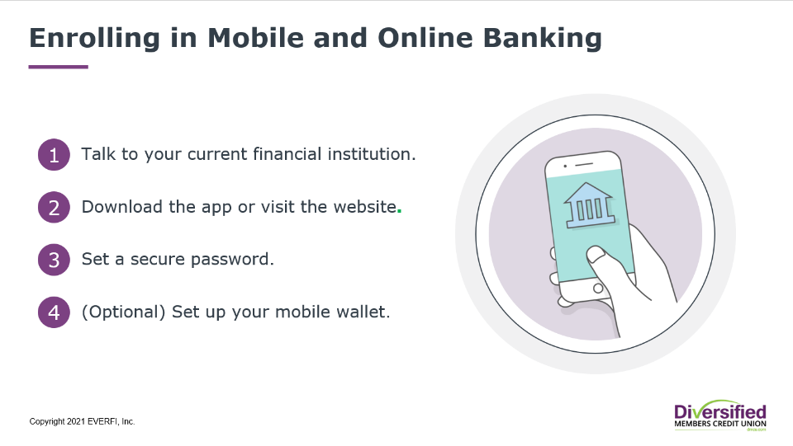

Slide 58
6 Best Practices For Staying Secure
Use a strong password and keep it secret. If you use a mobile banking app on your mobile device, use a different, secure password for your banking app that the one you use for your phone’s device lock.
Always use a secure internet connection. Websites using SSL (Secure Lock Layer encryption) always show a web address that starts with https:// which indicates that you are on a secure site.
Verify who you are communicating with. If someone contacts you online and claims to work for your financial institution, contact your financial institution directly to be sure the person is actually a representative.
Download from a trusted source. Downloading mobile banking apps from reputable sources, such as your bank’s website or a valid app marketplace.
Regularly monitor your accounts and transactions. This way you can sport and report fraud to your bank right away.
Don’t forget to log out. Log out of all bank websites if you check your accounts on a public computer.

Slide 60
Questions

Slide 61
5 Key Benefits

Slide 62
Michigan’s Coordinated Access to Food for the Elderly (MiCAFE)
MiCAFE, a program of Elder Law of Michigan, Inc., helps individuals apply for benefits that meet their basic needs including food, utilities, medical assistance, and prescriptions. Application assistance is available over the phone and is primarily for people age 60 and older.
If you or someone you know is 60 or older and living on a limited income, MiCAFE is here to help! MiCAFE will help you or your loved one apply for benefits you might have earned but may not know about.

Slide 63
5 Key Benefits
Supplemental Nutrition Assistance Program
(SNAP)
Medicaid
Medicare Savings Program
(MSP)
Medicare Extra Help/Low Income Subsidy (LIS)
State Emergency Relief
(SER)

Slide 64
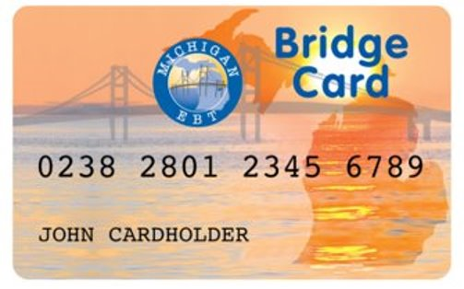
Supplemental Nutrition Assistance Program (SNAP)
Supplemental Nutrition Assistance Program is a federal program that provides nutrition benefits to low-income individuals and families.
SNAP benefits are issued via the Michigan Bridge Card and recipients can use them at participating stores and farmers markets to purchase food.
Over 48% of seniors eligible for SNAP do not apply for or receive the benefit. The purpose of SNAP is to end hunger, improve nutrition, and improve health. Seniors facing hunger have an increased risk of developing health issues like heart attack and congestive heart failure.

Slide 65
SNAP Eligibility
Traditional Eligibility:
Gross Monthly income - Household gross monthly income must be at or below 130 percent of federal poverty level (FPL) or if Senior/Disabled/Disabled Veteran use 200% FPL
Net Income - Household net monthly income must be at or below 100 percent of federal poverty line after deductions are applied.
Asset limit - $15,000
Citizenship - Only U.S. citizens and certain lawfully-present non-citizens may receive SNAP benefits.

Slide 66
SNAP Eligibility Overview
Household
live together and purchases and prepares meals together
Assets
15,000
Income
Gross Income either 130% ($1,396) or 200% of FPL ($2,148)
Net income of 100 % FPL ($1,074)
Expenses
Allowable deductions
Standard Medical Deduction
Citizenship
Citizenship or certain eligible status

Slide 67
Medicaid
Medicaid is a low-income healthcare program that is funded by the state and federal government and run by the state.
Available to low-income persons aged 65 or older; blind or permanently disabled persons; members of families with dependent children; children in foster care homes; pregnant women; and individuals under age 21 in psychiatric hospitals.

Slide 68
Medicaid Eligibility
Applicant
Single
Married (both)
Married (one)
Assets
2,000
3,000
3,000
Very Low-Income(100% FPL)
$1,133
$1,526
$1,526
Low-Income (133% FPL)
$1,506
$2,029
$2,029
Citizenship
Michigan and U.S. citizenship or certain eligible status

Slide 69
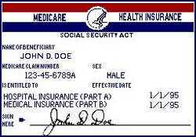
Medicare and Medicare Savings Program
Medicare is federal health insurance program available, regardless of income, medical history, or health status, to persons who are 65 or older, certain younger people with disabilities and people diagnosed with end-stage renal disease (ESRD) and amyotrophic lateral sclerosis (ALS)
Medicare consists of:
Medicare Part A (Hospital Insurance)
Premium-Free Part A: Eligible for Social Security Retirement and paid payroll taxes for 10 or more years
Premium for Part A: Either $499 a month or $274 depending on work history/payroll taxes.
Medicare Part B (Medical Insurance)
Part B premium amount in 2021 is $170.10 (unless eligible for the Medicare Savings Program, which we will cover soon)
Medicare Part D (prescription drug coverage)
Government contracts with private companies and therefore the Part D monthly premium varies by plan (unless eligible for the Medicare Extra help/Low-income subsidy, which we will cover soon)

Slide 70
Medicare Savings Program
Medicare Savings Programs (MSP) are federally funded programs administered by each individual state. MSP may help pay some or all the
Medicare premiums, deductibles, copayments and coinsurance.
Qualifications for MSP is based on income and asset (resources) limits.
Applicant
Individual
Couple
Assets –SSI related Medicaid
8,400
12,960
Assets – all other Medicaid
$2,000
$3,000
Very Low-Income
(100% FPL)
$1,153
$1,546
Full coverage,
Low-Income
(100-120% FPL)
$1,153.01-1,379
$1,546.01-1,851
Part B paid
Citizenship
Michigan and U.S. citizenship or certain eligible status

Slide 71
Medicare Extra Help
Medicare Extra Help can help individuals with limited resources and income “get Extra Help with the costs — monthly premiums, annual deductibles, and prescription co-payments — related to a Medicare prescription drug plan. Social Security/Medicare decides if you qualify for the program known as “Extra Help” that helps with drug costs.
Qualifications for Medicare Extra Help/Low Income Subsidy is based on income and asset (resources) limits.
Applicant
Individual
Couple
Assets
$15,510
$30,950
Income
(135-150% FPL)
$1,719
$2,309

Slide 72
State Emergency Relief Program (SER)
The State Emergency Relief Program (SER) provides financial assistance/money quickly for emergencies such as to prevent an eviction, stop a utility shut off, or pay for a burial.
SER eligibility is based on the household composition, monthly income and countable assets.
Applicant
Individual
Couple
Assets
$15,000
Income –LIHEAP/Energy
(150% FPL)
$1,699
$2,289

Slide 73
Michigan’s Coordinated Access to Food for the Elderly (MiCAFE)
If you or someone you know is 60 or older and living on a limited income, MiCAFE is here to help! MiCAFE will help you or your loved one apply for benefits.
MiCAFE Call Center Support
Open 9:00 am – 3:00 pm
Monday – Friday
1-877-664-2233

Slide 74
Darling Garcia

Slide 75
HAVE A PLAN THAT SIMPLIFIES YOUR FINANCIAL SITUATION
UNMUTE YOURSELF BY PRESSING*6, STATE YOUR NAME AND ASK THE QUESTION AFTER YOU ARE CALLED UPON.
‹#›
Notes:
‹#›

Slide 76
.
know the five
key benefits
how to use
technology
avoid senior scams and
protect your identity
‹#›
Notes:
‹#›

Slide 77
Money Smart Event
CLOSING REMARKS
If you would like to set up an appointment to be screened for the five key benefits, please call Elder Law of Michigan (ELM) at: 1-877-644-2233.
An ELM benefits counselor can assist you to apply for a SNAP/bridge card, Medicaid, the Medicare Low Income Subsidy, Medicare Extra Help and State Emergency Relief (SER).
If you are interested in future Senior Money Smart Expo Events, type your email into the Chat Message Box in Zoom or visit www.semisrc.org
Most of the PowerPoint presentations for today’s event can be found on the Senior Regional Collaborative home page at: www.semisrc.org

Slide 78
Money Smart Event
EVENT SPONSORS
Special Thanks to our event sponsors:
Elder Law of Michigan
Detroit Area Agency on Aging
Association of Chinese Americans
SRC Benefits Access Committee
‹#›
Notes:
‹#›

Slide 79
AND THE WINNER OF THE VIRTUAL DOOR PRIZE IS?...
‹#›
Notes:
‹#›

Slide 80
SRC – Thirty five organizations serving older persons and adults with disabilities in and throughout Southeast Michigan
Answers I Advocacy I Action
Senior Regional Collaborative
6900 McGraw Avenue
Detroit, Michigan 48201
www.semisrc.org
Call DAAA at (313) 446-4444, Ext. 5228 and leave your email address for future programs
‹#›
Notes:
‹#›

