Slide 1
Comprehensive Benefits Counseling
Using BenefitsCheckUp to Help Your Clients
Brandy Bauer Emily McDonald
April 6, 2022

Slide 2
The National Council on Aging (NCOA): Who we are
Vision
A just and caring society in which each of us, as we age, lives with dignity, purpose, and security
Mission
Improve the lives of millions of older adults, especially those who are struggling
Goal
Impact the health and economic security of 40 million older adults by 2030, especially women, people of color, LGBTQ+, low-income, and rural individuals

Slide 3
Our Focus Areas
Healthy Living
Financial Security
Prevention
Physical Health
Behavioral Health
Aging Mastery
Benefits Enrollment
Money Management
Job Training
Retirement Planning

Slide 4
Agenda
1. What is BenefitsCheckUp: Overview & Comparison with MI Bridges
2. Quick Search for Resources
3. Comprehensive Screening
4. Case Scenarios: Helping Clients with Complex Needs
5. Other Resources (Including a New Tool for Michigan)

Slide 5
Poll: What are the most common benefits you help seniors with?
Medicaid
Medicare Savings Programs
Other Prescription/Health Care Programs
Food Assistance
Utility Assistance
Housing
Others?

Slide 6
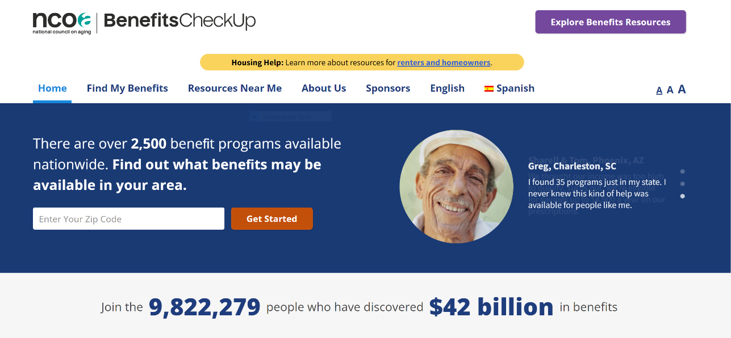
BenefitsCheckUp
www.BenefitsCheckUp.org Also in Spanish: www.BuscaBeneficios.org

Slide 7
MI Bridges vs. BenefitsCheckUp
newmibridges.michigan.gov
www.BenefitsCheckUp.org
Requires site registration to search for resources and apply for programs
Portal for Michiganders of all ages
Focuses exclusively on Michigan programs
Available in English, Spanish & Arabic
Focus is on application and case management (document upload, tracking benefits & renewals)
No site registration required; all screening done anonymously
Portal specially focused on programs benefitting adults aged 55+
While searchable at zip code level, includes Federal, state, and (some) local programs
Available in English & Spanish (program applications in many languages)
Focus is on eligibility screening; links to applications/portals
NOT an application tool (except for Part D Extra Help)

Slide 8
Types of Programs in BenefitsCheckUp
Health Care
Prescriptions
Housing & Utilities
Income Assistance
Medicaid
Home & Community-Based Services
SCHIP
Chore Services
Donated Dental Care
Vision Care
Part D Extra Help
Patient Assistance Programs
State Pharmaceutical Assistance Programs
Rx Discount Cards
LIHEAP
Weatherization & Home Repair
HUD Housing & Vouchers
Broadband & Phone Service
Supplemental Security Income (SSI)
General/Cash Assistance
Pension Services
Tax Relief
Veterans Benefits
Food Assistance
Other Programs
Property Tax Rebates and Discounts
Earned Income Tax Credit
Homestead Exemptions
Federal Tax Credits
Pre-paid Burial
Aid & Attendance Benefits
Death Pension
Home Loans
SNAP/Food Stamps
Senior Farmers’ Market Nutrition Program
Commodity Supplemental Food Program
Home-Delivered/ Congregate Meals
Senior Community Service Employment Program (SCSEP)
Assistive Technology
Respite Care
Legal Services
Transportation

Slide 9
Quick Search for Resources & Comprehensive Screening

Slide 10
Upcoming Changes to BenefitsCheckUp
Coming this June
Quick access to benefit assistance programs and resources using search and filter tools.
Users will have the ability to screen:
For a single program
At the category level (e.g., prescription assistance)
All programs (comprehensive screening)
Users will see an estimated value of the benefit on the program page
Improved design on personalized report page
Clear infographic outlining next steps to apply
Articles and related programs to get more information about a category or find related resources
Notes:
Mention lack of pre-screen

Slide 11
Counseling Scenarios

Slide 12
Questions to Consider
What is the client’s immediate need?
To extent you’re able, assist with application/referral
“Are you getting any help from other programs?”
Ask about other members of the household (including military service)
Other questions that may uncover other areas of need:
“Do you have enough of your medications?”
“Have you been able to keep up with rising food costs?”
“Can I help see if there are other ways we can free up some money in your budget?”
Offer follow-up to check on award status, other programs

Slide 13
Sylvia from Grand Rapids
Zip code 49505
Sylvia, 68, comes to you because she received a letter from Social Security about needing to confirm she is still eligible for the Part D Extra Help program. Her only income is a monthly Social Security benefit of $1,143.
You learn she is enrolled in Extra Help and SLMB (one of the Medicare Savings Programs), but she mentions high medical costs: her Part D plan doesn’t cover one of her three prescriptions, and as a cancer survivor, she has a lot of follow-up therapy and appointments that have co-pays.
What are some of the ways you could help her?

Slide 14
Helping Sylvia
Zip code 49505
Help Sylvia respond to the letter from Social Security
Use Medicare Plan Finder to see if another Part D plan could better meet Sylvia’s needs
Or refer her to a local MMAP counselor for help with Medicare
Search for prescription assistance programs in BenefitsCheckUp (especially if there isn’t a Part D plan that meets her needs)
Ask about her participation/gauge interest in other programs
Mention that she can deduct excess medical expenses and qualify for Food Assistance

Slide 15
Robert from Detroit
Zip code 48205
Robert, 62, is a recent widower who is raising his two minor grandsons, aged 15 and 12. He receives Medicare due to disability and brings in roughly $1,500 a month between a small pension and SSDI.
Robert’s furnace is very old and his home has been hard to heat this winter; he worries about the effect this has on one of his grandsons, who has asthma. He comes to ask about a Home Heating Credit program he’s heard about.
What are some of the ways you could help Robert?

Slide 16
Helping Robert
Zip code 48205
Screen for Home Heating Credit (LIHEAP) and other utility benefits
Talk to him about the age of his furnace and see if Weatherization Assistance might be able to help
Ask whether he needs help with property taxes
Ask about his grandsons’ health
Do they have insurance?
Does he get any help with their expenses?
Does his grandson with asthma have access to inhalers/other medications?
Ask about his participation/gauge interest in other programs

Slide 17
Samira from Mount Clemens
Zip code 48043
Samira, 45, is worried about her aging parents, who came to the U.S. from Lebanon in the 1980s and are naturalized citizens.
Samira’s parents live in a house they own, and her mother struggles to care for Samira’s father, who has dementia. Samira is calling because their Food Assistance benefits recently decreased, while the cost of her father’s care is rising.
What are some of the ways you could help Samira and her parents?

Slide 18
Helping Samira’s Parents
Zip code 48043
Consider reasons why Food Assistance decreased
Expiration of supplement from COVID legislation?
Change in income?
Have they taken advantage of excess medical expense deduction?
Might they get assistance from other food programs?
Ask about parents’ health insurance
Are they enrolled in Medicare? MA or Part D?
Do they get any help with costs (MSP/Extra Help)?
Refer to MMAP (as needed)
Look into whether Samira’s mother may be open to respite care/adult day care

Slide 19
Other Resources
& A New Tool for Michigan

Slide 20
NCOA’s website
Information on MIPPA, resources and fact sheets on core benefit programs
Sample outreach materials and toolkits
Promising practices in benefits outreach and enrollment
Mapping/data visualization tools
https://www.ncoa.org/professionals/benefits/ center-for-benefits-access

Slide 21
Benefits Basics from NCOA
Core benefits “cheat sheet” with basic eligibility, administering agency info
https://ncoa.org/article/medicare-core-benefits-cheat-sheet
Benefits 101 training slides
https://ncoa.org/article/benefits-101
Medicare Savings Program eligibility & coverage chart
https://ncoa.org/article/medicare-savings-programs-eligibility-coverage
Extra Help eligibility & coverage chart
https://ncoa.org/article/part-d-low-income-subsidy-extra-help-eligibility-and-coverage-chart

Slide 22
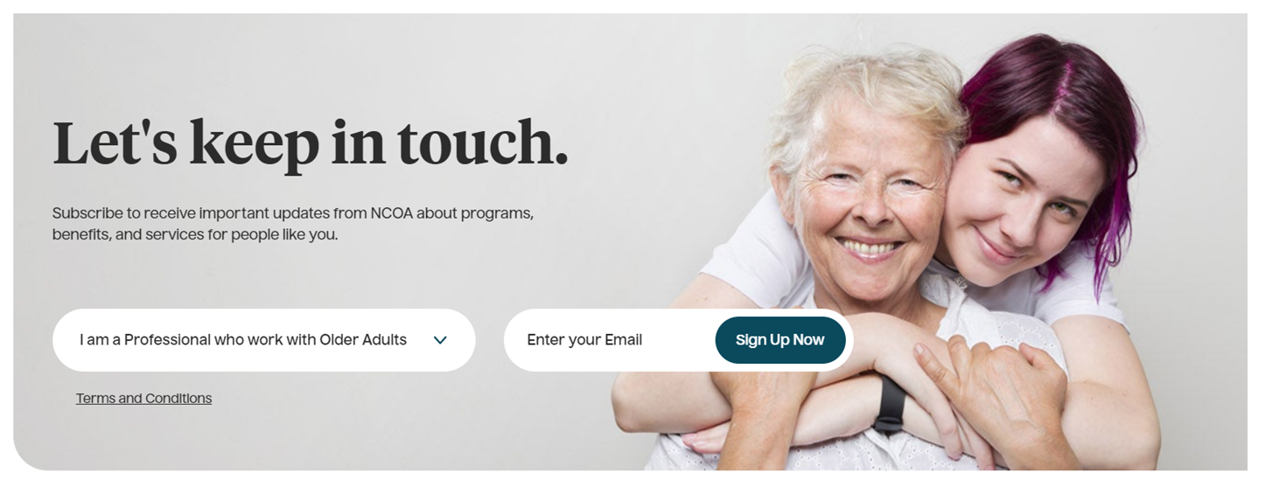
NCOA’s Benefits Alert Newsletter
Subscribe to the Benefits Alert monthly newsletter on ncoa.org then look for the following sign-up box at bottom of pages

Slide 23
Benefits Helpline/BCU Call Center
NCOA partnership with GreenPath Financial Wellness
Toll-free number appears on BenefitsCheckUp
Available in English & Spanish, M-F 9-5 ET
Two-pronged approach:
Information and referrals for those with non-benefits needs
Assistance completing a BCU screening and receiving personalized report and applications

Slide 24
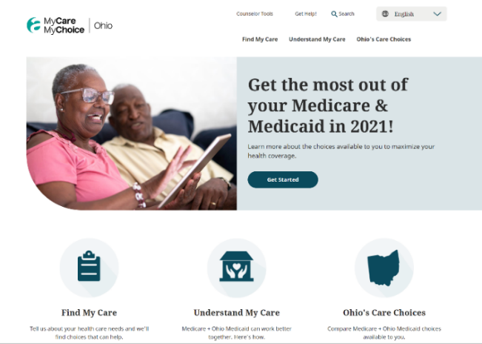
My Care, My Choice – Coming This Fall to MI!
Originally created by SCAN Foundation for California; now in CA & OH
Walks through different coverage options for people with Medicare & full Medicaid (dual eligibles), including MI Health Link plans, PACE, Medicare Advantage plans, and Original Medicare + MI Choice Waiver
Counselor tools include comparison chart of integrated care options
Going live for Michigan this fall (2022)
Looking for beta testers and counselors to help roll it out
www.mycaremychoice.org

Slide 25
Contact
Brandy Bauer
Brandy.bauer@ncoa.org
Emily McDonald
Emily.mcdonald@ncoa.org

